Slide 1
Software Testing Methodologies
Prashant Joshi

Slide 2
Module 10: Agenda
Module 10: Object Oriented Testing (2/2)
Topic 10.1
OO Integration Testing
Topic 10.2
OO System Testing
Topic 10.3
OO – GUI Testing
Topic 10.4
Examples

Slide 3
Topic 10.1: OO Integration Testing

Slide 4
Petri Nets
Major use:
Modeling of systems of events in which it is possible for some events to occur concurrently, but there are constraints on the occurrences, precedence, or frequency of these occurrences

Slide 5
Petri Nets as a Graph
Models static properties of a system
Graph contains 2 types of nodes
Circles (Places)
Bars (Transitions)
Petri net has dynamic properties that result from its execution
Markers (Tokens)
Tokens are moved by the firing of transitions of the net.

Slide 6
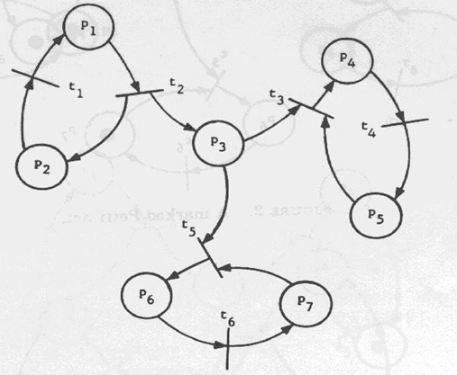
Graph representation

Slide 7
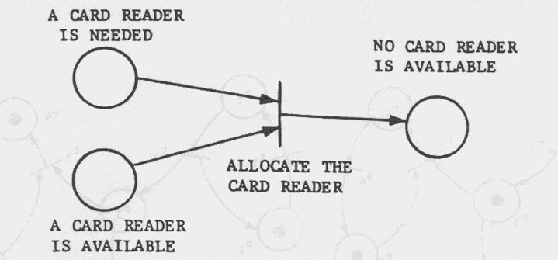
A Simple Model

Slide 8
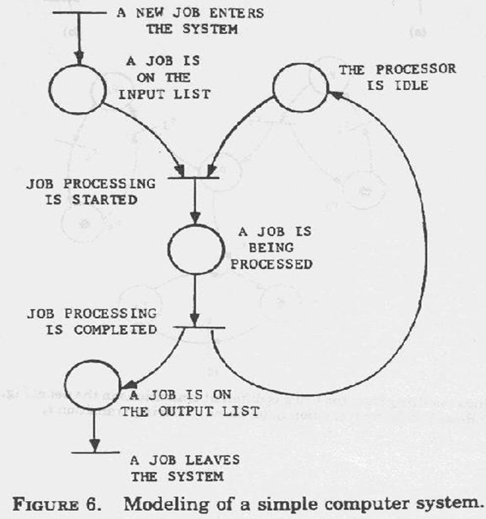
Model Example

Slide 9
OO Integration Testing
Flattened to Hierarchy
Test methods to be removed
Polymorphism – Test in each polymorphic context

Slide 10
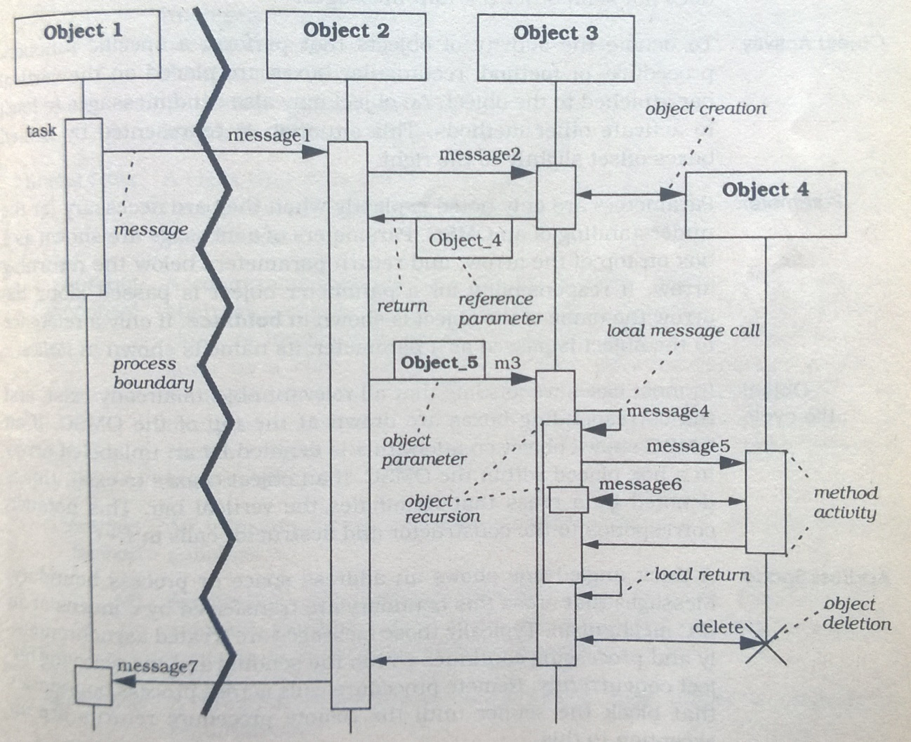
Message Sequence Charts – Dynamic View
Adapt MSC to demonstrate object or component interaction among the participants
of a pattern

Slide 11
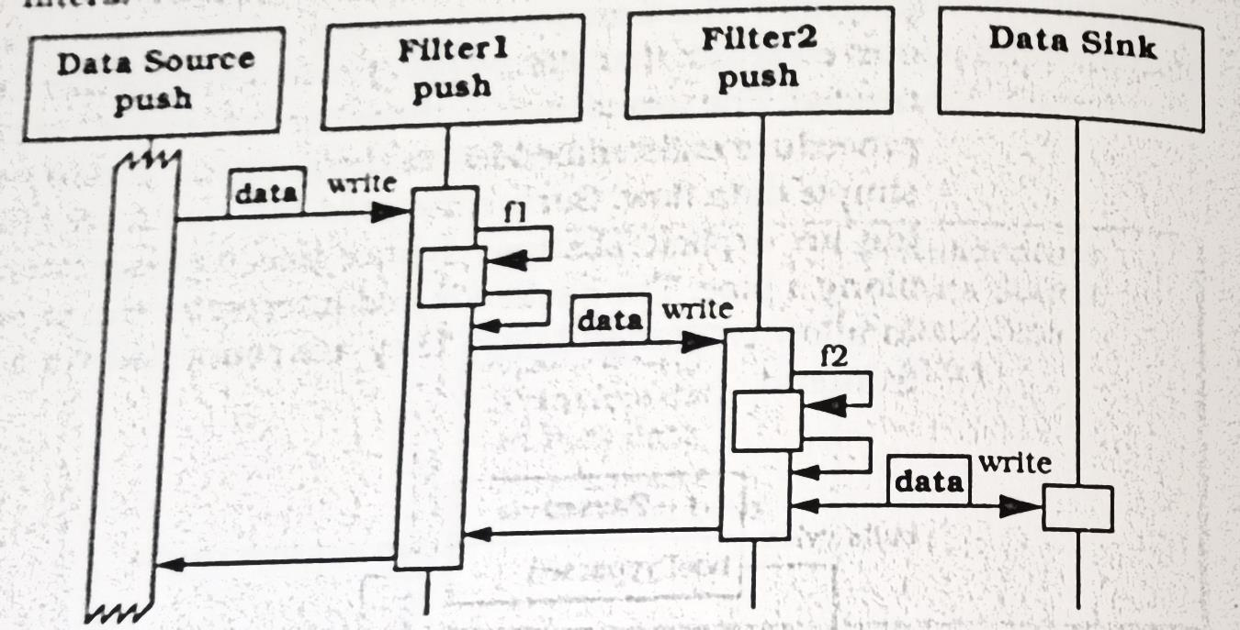
Example
Scenario for Pipes & Filters
Push pipeline
Filter activity started by writing data to the filters

Slide 12
OO Integration
MM Paths (Sequence of method execution linked by messages)
Use of Data Flow

Slide 13
Software Testing Methodologies
Prashant Joshi

Slide 14
Topic 10.2: OO System Testing

Slide 15
System Testing
System testing is concerned with the behaviour of a whole system. The majority of the functional failures should already have been identified during unit and integration testing
System testing is usually considered appropriate for comparing the system to the non-functional system requirements, such as security, speed, accuracy, and reliability. External interfaces to other applications, utilities, hardware devices, or the operating environment are also evaluated at this level.

Slide 16
System Testing
It is essential to define what the “system” is made up of
A system for one team/organisation may mean a module/part of a larger system
Generally system level is treated as closest to everyday experience i.e. system (Product) as seen in the hands of the user
In system testing apart from finding faults the goal is to demonstrate
System works
System is reliable
System is durable
Quality of system for defined parameters
Use of specification based testing techniques to design test cases

Slide 17
System Testing – Aspects
Thread
Thread Possibilities
Thread Definitions
Atomic Thread Function

Slide 18
System Requirements – Basic Concepts
Data
Information used and created by the system
Actions
Transform, data transform, control transform, process, activity, task, method, service
Devices
Source and destination of system level inputs and outputs
Events
System level I/O; occurs on port device; inputs and outputs of actions
Threads
Model of a system – interactions among data, events and action

Slide 19
OO System Test
Test Engineer treats system as Black Box!
Look for input and output events
OO or Procedural Implementation
Requirements model
Use of Petri nets

Slide 20
Focus of Our Testing
Requirements
System Functions
Presentation Layer
The way the user or customer sees it!

Slide 21
System Functions
Use of description by customer/user in general terms
User Stories → Use Cases
Gives rise to system functions
Evident (Input currency amount)
Hidden (Maintain ex-or relationship among countries)
Frill (Display of country flags)

Slide 22
Presentation Layer
Sketching of UI
Relating User Experience to the user stories and use cases (Making it simple and easy to use)
Screen transition and Navigation
Currency Converter
Quit
Indian Rupees
US Dollars
Euro
Compute
Clear
Pounds
Japanese
Custom
Equivalent

Slide 23
Use Case Based Testing
High level Use Cases
Essential Use Cases
Expanded Essential Use Cases
Each level bring in more refinement in what is done as part of the use case
Refine only as much it is required

Slide 24
Example: Use Case
HLUC
User Starts the currency converter application in Windows
EUC
Add an event sequence
Input: User starts the application by using Run command, double click the application icon
Output: The CC application GUI appears on the screen
EEUC
Add next level details
Details like: Which input box or area has focus. Specifics on static or dynamic data shown on the screen. Any details on memory or specifics of post-condition to be checked.
Refine

Slide 25
State Based
State Based Testing
Use of Extended Finite State Machine

Slide 26
Software Testing Methodologies
Prashant Joshi

Slide 27
Topic 10.3: OO – GUI Testing

Slide 28
Currency Converter System
Currency Converter
Quit
Indian Rupees
US Dollars
Euro
Compute
Clear
Pounds
Japanese
Custom
Equivalent

Slide 29
Top areas of focus
Main characteristic of GUI Testing: Event Driven
Users can cause any of several events in any order
Buttons have functions; and they can be tested
Focus: test the event driven nature: System Testing of GUI
Also at level of unit one can test the function of buttons
Use of Finite State Machines and Extended Finite State Machines

Slide 30
Testing a GUI Application
Identify all the user input events
Identify all the system output events
Externally visible & observable
Use the System Level State Machine (State Chart)
Use of artificial events (Idea is to simplify the system level state machine)

Slide 31
Unit & Integration Testing
Example of currency converter program
Unit Level Testing (Level: Open for discussion)
Use of Input and Output for that “unit”
System level unit testing! (This poses some issues)
Test Driver is preferred for unit testing (Ensures testing of input, output and/or computation
Method or Class as Unit (Remember out discussion on choosing either)
Integration Level Testing
With unit level thoroughly tested; is integration required?
Definition of “integration level”

Slide 32
Automated Teller Machine
ATM System
Terminal I/O
Manage Sessions
Conduct Transactions
Card Entry
PIN Entry
Select Transactions
Source: T1: Figure 12.2

Slide 33
Software Testing Methodologies
Prashant Joshi

Slide 34
Topic 10.4: Examples

Slide 35
Garage Door
The device controls for opening and closing the door are different for the various product lines. They may include controls from within a home information system. The product architecture for a specific set of controls should be directly derivable from the product line architecture
The processor used in different processes will differ. The product architecture for each specific processor should be directly derivable from the product line architecture
If an obstacle (person or object) is detected by the garage door during descent, it must halt (alternately re-open) within 0.1 second
The garage door opener should be accessible for diagnosis and administration from within the home information system using product specific diagnosis protocol. It should be possible to directly product an architecture that reflects this protocol

Slide 36
Garage Door
User Interface
Diagnosis
Raising/Lowering Door
Obstacle detection
Communication Virtual Machine
Sensor/Actuator Virtual Machine
Scheduler That guarantees deadlines

Slide 37
Software Testing Methodologies
Prashant Joshi

